Slide 1
Materials Science and Engineering
Dr. Ranjit Kumar
Department of Chemical Engineering
Email: ranjit.kumar@snu.edu.in

Slide 2
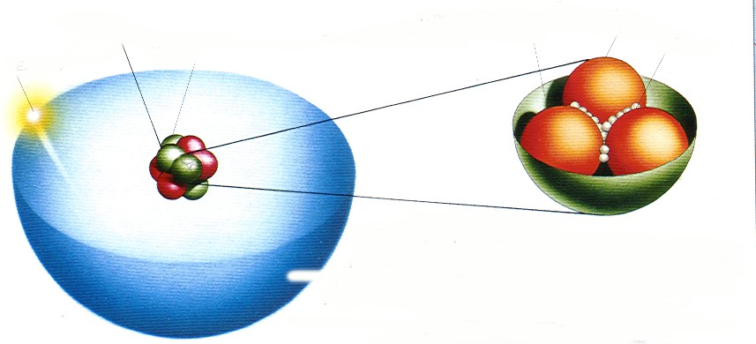


Atomic structure
Nucleus
Neutron
Quarks Gluons
Electron
Protons
BOHR ATOM
orbital electrons: n = principal quantum number
₂ 1
n=3
Nucleus: Z = # protons
= 1 for hydrogen to 94 for plutonium Atomic mass A ≈ Z + N N = # neutrons
12

Slide 3
Electronic structure
Valence electrons determine all of the following properties:
Chemical
Electrical
Thermal
Optical
Electrons have wavelike and particulate properties.
This means that electrons are in orbitals defined by a probability.
Each orbital at discrete energy level determined by quantum numbers.
Quantum #
n = principal (energy level-shell)
l = subsidiary (orbitals)
m_{l} = magnetic
m_{s} = spin
Designation
K, L, M, N, O (1, 2, 3, etc.)
s, p, d, f (0, 1, 2, 3,…, n -1)
1, 3, 5, 7 (-l to +l)
½, -½

Slide 4
Electronic structure
Principal quantum no. | Shell designation | Subshells | No. of states | Number of electrons
 |  |  |  | Per subshell | Per shell
1 | K | s | 1 | 2 | 2
2 | L | s p | 1 3 | 2 6 | 8
3 | M | s p d | 1 3 5 | 2 6 10 | 18
4 | N | s p d f | 1 3 5 7 | 2 6 10 14 | 32
f
d
p s
f
d
d
p
s
p s
p s
s
1
2
3
4
5

Slide 5
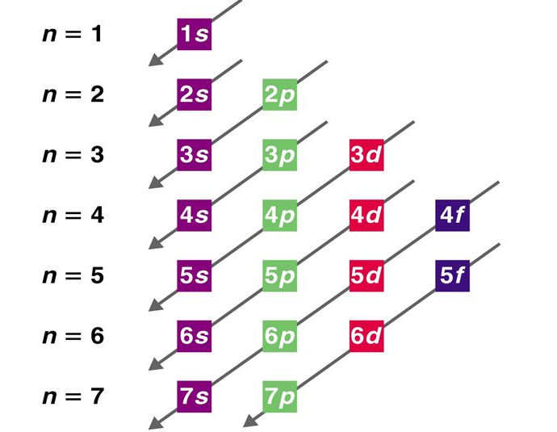
Atomic Structure
Electron energy state
Occupy the atomic no. at the lowest energy state to higher energy state
Low
K shell
L shell
M shell
N shell
No. of electron can occupy each orbital:
s = 2; p = 6; d = 10; f = 14
High
Notes:
n= principal quantum no; shell or energy level
l= orbital momentum quantum no; subshell of electron; s=0; p=1; d=2; f=3 so forth
Ml= magnetic quantum no; orbital of a given subshell; -l<x<+l
Ms= spin magnetic quantum no; +1/2 / -1/2
Aufbau principle: 1s<2s<2p …
Madelung rule: dalam figure

Slide 6
Electron energy states
Electrons...
have discrete energy states
tend to occupy lowest available energy state.
4d 4p
N-shell n = 4
3d
4s
3p 3s
Energy
M-shell n = 3
2p 2s
L-shell n = 2
1s
K-shell n = 1

Slide 7
Electronic configuration
ex: Fe - atomic # = 26
1s² 2s² 2p⁶ 3s² 3p⁶
3d ⁶ 4s²
valence electrons
4d 4p
N-shell n = 4
3d
4s
3p 3s
Energy
M-shell n = 3
2p 2s
L-shell n = 2
1s
K-shell n = 1

Slide 8
Survey of elements
Most elements: Electron configuration not stable.
Element Hydrogen Helium Lithium
Atomic #
1
2
3
Electron configuration 1s ¹
1s ²
(stable)
1s ² 2s ¹
1s ² 2s ²
Beryllium
4
Boron | 5 | 1s | ² 2s | 2 _{2p} 1
Carbon ... | 6 | 1s | ² 2s | 2 _{2p} 2
Neon | 10 | 1s | ² 2s | ² 2p ⁶ (stable)
Sodium | 11 | 1s | ² 2s | ² 2p ⁶ 3s ¹
Magnesium | 12 | 1s | ² 2s | ² 2p ⁶ 3s ²
Aluminum ... | 13 | 1s | ² 2s | ² 2p ⁶ 3s ² 3p ¹
Argon | 18 | 1s | ² 2s | ² 2p ⁶ 3s ² 3p ⁶ (stable)
... | ... | ...
Krypton | 36 | 1s | ² 2s | ² 2p ⁶ 3s ² 3p ⁶ 3d ¹⁰ 4s ² 4p ⁶ (stable)
...
...
Why? Valence (outer) shell usually not filled completely.

Slide 9
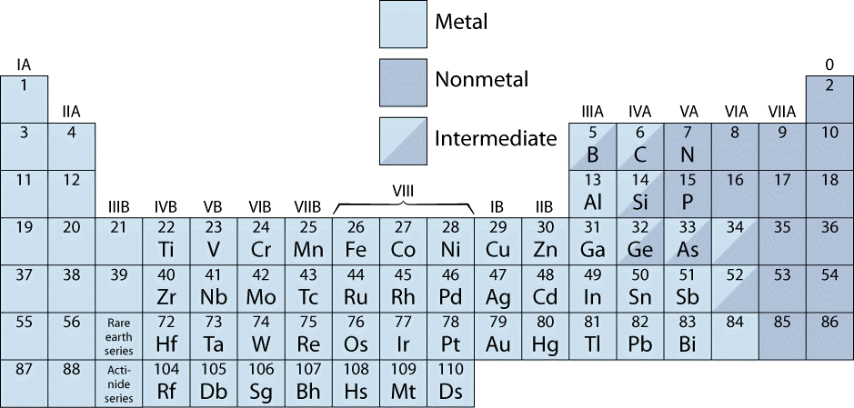
The periodic table
Columns: Similar Valence Structure
give up 1e
give up 2e p 3e
accept 2e
accept 1e
inert gases
H Li Na
 | Be Mg | give u
K | Ca | Sc
Rb Cs Fr | Sr Ba Ra | Y
 |  | He Ne
O | F
S | Cl | Ar
Se | Br | Kr
Te | I | Xe
Po | At | Rn
Electropositive elements: Readily give up electrons to become + ions.
Electronegative elements: Readily acquire electrons to become - ions.

Slide 10
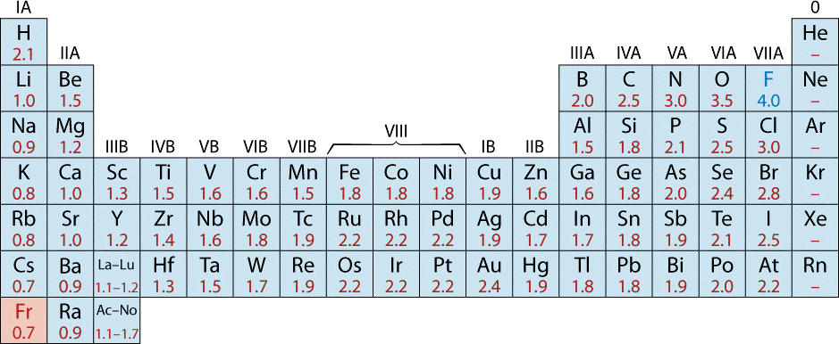
Electronegativity
Ranges from 0.7 to 4.0,
Large values: tendency to acquire electrons.
Smaller electronegativity
Larger electronegativity
Adapted from Fig. 2.7, Callister 7e. (Fig. 2.7 is adapted from Linus Pauling, The Nature of the Chemical Bond, 3rd edition, Copyright 1939 and 1940, 3rd edition. Copyright 1960 by Cornell University.

Slide 11

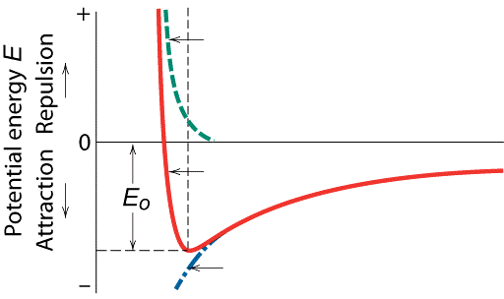
Bonding forces and energies
Attractive force, F_{A}
Repulsive force, F_{R}
Repulsive force : Dominates at small distance
Attractive force : Dominates at larger distance
At equilibrium : Both are equal
Low energy : The element is more stable
r
+
Attractive force, F_{A}
E = ∫ Fdr
Force F
Attraction
r r r
E_{N} = ∫ F_{N} dr = ∫ F_{A} dr + ∫ F_{R} dr
∞ ∞ ∞
0
Repulsion
Interatomic separation r
= E + E
Repulsive force, F_{R}
Net force, F_{N}
-
Repulsive energy E_{R}
Interatomic separation r
Net energy
E_{N}
Attractive energy E_{A}
A R
(a)
(a) The dependence of repulsive, attractive, and net forces
on interatomic separation for two isolated atoms.
(b) The dependence of repulsive, attractive, and net potential energies on interatomic separation for two isolated atoms.
(b)

Slide 12
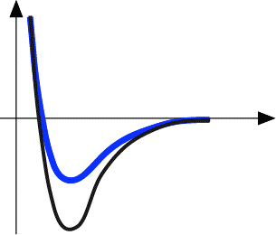


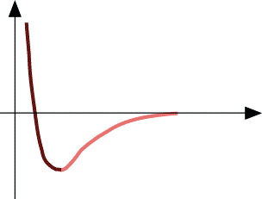
Properties from bonding
Bond length, r
Melting Temperature, T_{m}
Energy
r
Bond energy, E_{o}
r _{o}
r
Energy
smaller T_{m}
unstretched length
r
larger T
o
r
m
E_{o} =
T_{m} is larger if E_{o} is larger.
“bond energy”

Slide 13



Properties from bonding: thermal expansion coefficient
Coefficient of thermal expansion, α
length, L _{o}
coeff. thermal expansion
unheated, T₁
Δ L
Δ L
=
α
( T ₂ - T ₁ )
heated, T
L _{o}
2
α ~ symmetry at r_{o}
Energy
unstretched length
r _{o}
r
α is larger if E_{o} is smaller.
E_{o}
larger α
E_{o}
smaller α

Slide 14
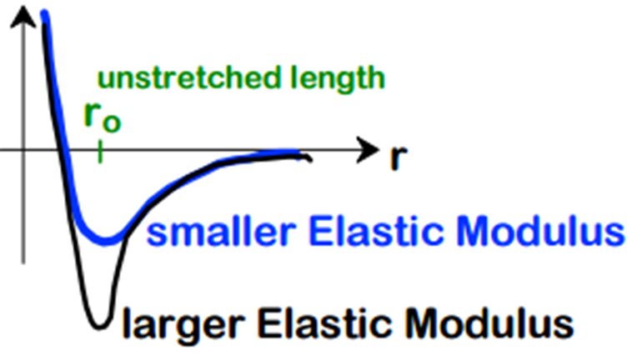
Properties from bonding: modulus E
F = kx
r

Slide 15

Types of bonding: ionic
Occurs between + and - ions.
Requires electron transfer.
Large difference in electronegativity required.
Example: NaCl
Na (metal)
unstable
Cl (nonmetal)
unstable
electron
Na (cation)
stable
+
-
Cl (anion)
stable
Coulombic Attraction

Slide 16







Examples of ionic bonding
Predominant bonding in Ceramics
NaCl MgO
CaF ₂
CsCl
Give up electrons Acquire electrons
Adapted from Fig. 2.7, Callister 7e. (Fig. 2.7 is adapted from Linus Pauling, The Nature of the Chemical Bond, 3rd edition, Copyright 1939 and 1940, 3rd edition. Copyright 1960 by Cornell University.

Slide 17


Covalent bonding
similar electronegativity ∴ share electrons
bonds determined by valence – s & p orbitals dominate bonding
Example: CH₄
C: has 4 valence e⁻, needs 4 more
shared electrons from carbon atom
H
CH₄
H: has 1 valence e⁻, needs 1 more
H
C
H
Electronegativities are comparable.
shared electrons
from hydrogen atoms
H

Slide 18
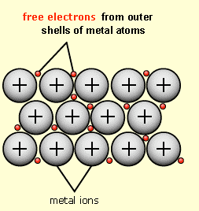
Metallic bonding
Ions in a sea of electrons
Attraction between free electrons and metal ions

Slide 19
Ionic-covalent mixed bonding
% Ionic character = {1 − exp[−(0.25)(XA − XB)²]} × 100
where X_{A} & X_{B} are Pauling electronegativities
Example: MgO
X_{Mg} = 1.3
X_{O} = 3.5
% ionic character = {1 – exp[- (0.25) (3.5 – 1.3)²]}
x (100%) = 70.2% ionic

Slide 20
Secondary Bonding
Secondary bonds, or van der Waals (physical) bonds, are weak in comparison to the primary or chemical bonds; bonding energies range between about 4 and 30 kJ/mol.
Secondary bonding exists between virtually all atoms or molecules, but its presence may be obscured if any of the three primary bonding types is present.
Secondary bonding is evidenced for the inert gases, which have stable electron structures.
Secondary (or intermolecular) bonds are possible between atoms or groups of atoms, which themselves are joined together by primary (or intramolecular) ionic or covalent bonds.
Van der Waals forces are of two types
Fluctuating Induced Dipole Bonds (London Forces)
Polar Molecule–Induced Dipole Bonds

Slide 21











Secondary bonding
Arises from interaction between dipoles
Fluctuating dipoles
example: liquid H₂
H₂
asymmetric electron clouds
H₂
+
-
+
-
H H
H H
secondary bonding
secondary bonding
Permanent dipoles-molecule induced
secondary bonding
-general case:
+ -
+
-
secondary bonding
-example: liquid HCl
H
Cl
H Cl
-example: polymer
secondary bonding
secondary bonding

Slide 22
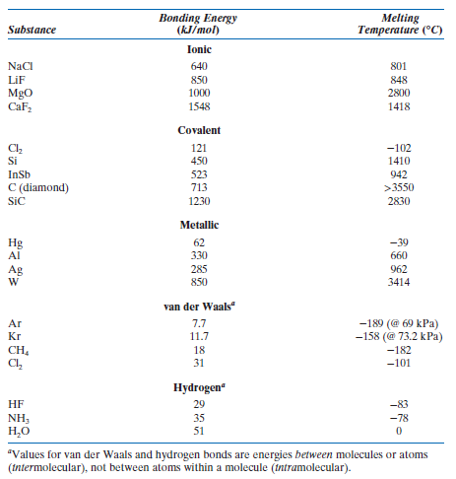
Bonding Energy and Melting Points of various substances

Slide 23
Summary
Type | Bond Energy | Comments
Ionic | Large! | Non-directional (ceramics)
Covalent | Variable Diamond (large) Bismuth (small) | Directional (semiconductors, ceramics, polymer chains)
Metallic | Variable Tungsten (large) Mercury (small) | Non-directional (metals)
Secondary | Smallest | Directional Interchain (polymer) Intermolecular
Ceramics (Ionic & covalent bonding) | Large bond energy Large T_{m} and E, small α
Metals (Metallic bonding) | Variable bond energy Moderate T_{m}, E, and α
Polymers (Covalent & secondary) | Directional properties, Secondary bonding dominates Small T_{m} and E, large α 30

